Slide 1

Signals & Systems
Course Code NO: EE-224
Department: BMED
Semester: 4th
Week-01
By
Dr. Wazir Muhammad Laghari
Electrical Engineering Department
BUET, Khuzdar

Slide 2
Signal & System
Contact Hours |  |  | Credit Hours:
Theory | 48 |  | Theory | 03
Practical | 48 |  | Practical | 01
Total | 96 |  | Total | 04
Recommended Books
1. Signals and Systems, Oppenheim A. V., Willsky A. S. and Nawab S. H., Prentice Hall, (Latest Edition).
2. Signals, Systems and Transforms, Phillips C. L. and Parr J. M., Prentice Hall, (Latest Edition)

Slide 3
Weekly Lecture Plan
First Week | Continuous time and Discrete time Signals.
Second Week | Periodic signals, Even and Odd signals, Exponential and Sinusoidal signals.
Third Week | The Unit Impulse and Unit Step functions, Continues Time and Discrete Time Systems.
Fourth Week | Test-1
Fifth Week | Linear Time Invariant (LTI) Systems, Difference Equation, Causality, BIBO Stability.
Sixth week | Convolution and Correlation
Seventh week | Discrete Time Fourier Transforms (DFT)
Eight week | Discrete Time Fourier Transforms DFT and FFT Algorithm.
Ninth week | Time and Frequency Characterization of Signals and Systems.
Tenth week | The Sampling Theorem, Aliasing, Sampling the Discrete Time Signals
Eleventh week | Test-2
Twelfth week | Z-Transform
Thirteenth week | Analysis and Characterization of LTI systems using z-transform, case studies: communication systems and linear feedback systems.
Fourteenth week | Analysis and Characterization of LTI systems using z-transform, case studies: communication systems and linear feedback systems.
Sixteenth week | Analysis and Characterization of LTI systems using z-transform, case studies: communication systems and linear feedback systems.

Slide 4
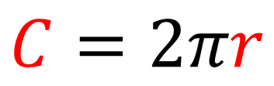
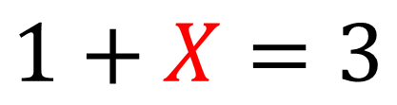
Variable
An unknown quantity, often designated by a Letter, that can take on different values in an expression or operation.
$$1+X=3$$
$$C=2πr$$
Variable
Variable

Slide 5
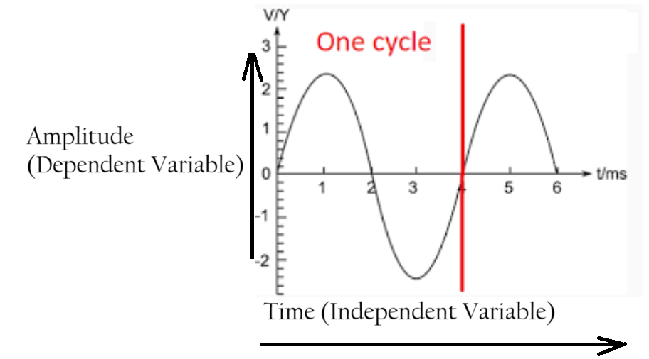
Dependent And Independent Variable
A Dependent Variable (Effect) is a variable whose value depends on another variable.
An Independent Variable (Cause) is a variable whose value never depends on another variable.
Amplitude of Sine Wave depend on the Time, so Amplitude is Dependent Variable, and Time is Independent Variable.

Slide 6
Signal
Signals in electrical circuits are defined as the change of voltage or current with time.
In other words, electrical signals are electromagnetic or electrical waves that carry information in an electric network or circuit.
Transfer of data and information is done via signals, such as audio and video signals which helps in communication through any medium such as optical, electromagnetic, wireless, or wired medium.
Signals are processed through various devices like ICs (Integrated circuits), transistors, and diodes.

Slide 7
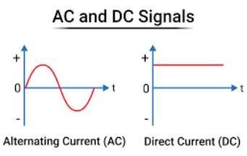
Signal
Any quantity is said to be a signal if it is a Varying with Independent Variable.
Anything which is constant is not a Signal.
Alternating current (AC) is a Signal, because it changes with respect to time.
Direct current (DC) is not a Signal, because it not changes with respect to time.
Some case DC consider as a Signal

Slide 8
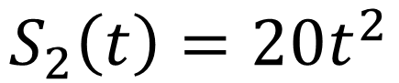
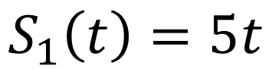
Signal
A signal is defined as any Physical Quantity that varies with time, space, or any other independent variable or variables.
Mathematically, a signal is a function of one or more independent variables. For Example, the functions describe two variables, one that varies linearly with the independent variable t (time) and a second that varies quadratically with t.
$$S_{1}\left(t\right)=5t$$
$$S_{2}\left(t\right)=20t^{2}$$

Slide 9
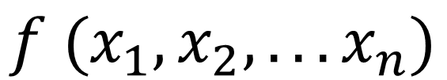
Mathematically Signal
Signal is a Dependent Variable of Function of One or More Independent Variable is known as a Signal.
Independent Variables
$$f (x_{1},x_{2}, . . .x_{n})$$
Signal

Slide 10
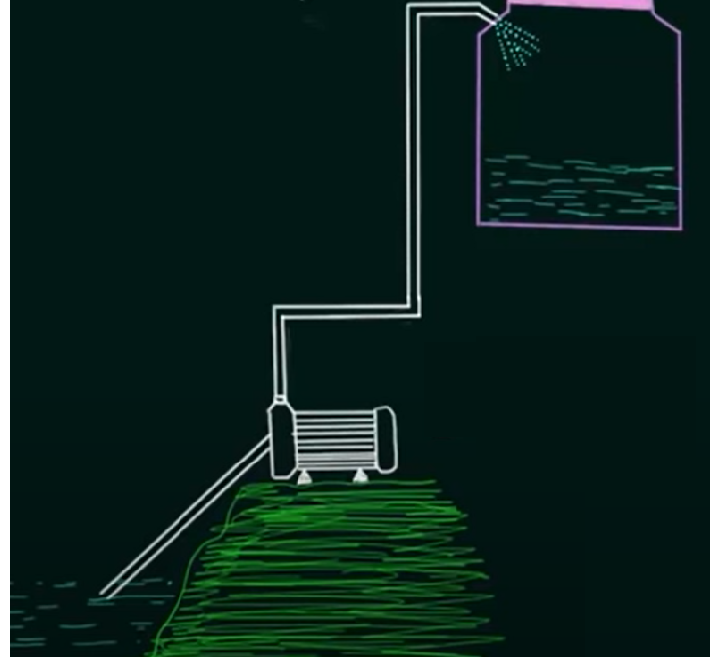
Signals And System
The meaningful interconnection of physical devices and components is called as a System.
A set of connected things or devices that operate together
It is denoted by rectangular box.
Electricity (Signal) provide a pump (system) than system (pump) perform mechanical work
System
Input Signal
Output Signal
Due to Electricity (Signal) provide a pump (system) than system (pump) provide another signal (output Signal) to fill the water pump
Water Pump = System

Slide 11
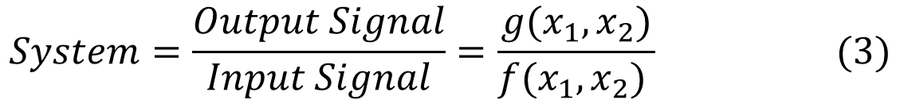
Signals And System
From Previous Slide we obtained two signals one is Input Signal and Other is Output Signal.
$$Input Signal=f\left(x_{1},x_{2}\right) (1)$$
$$Output Signal=g\left(x_{1},x_{2}\right) (2)$$
System
Input Signal
Output Signal
$$System=\frac{Output Signal}{Input Signal}=\frac{g(x_{1},x_{2})}{f(x_{1},x_{2}) } (3)$$
$$System∗Input Signal=Output Signal$$
$$Output Signal=System∗Input Signal (4)$$

Slide 12
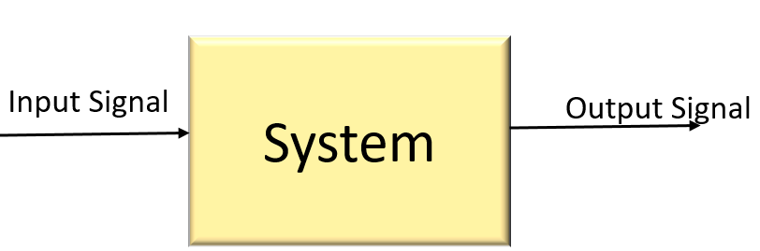
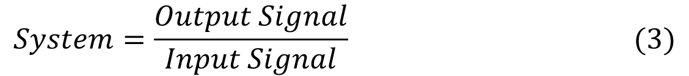
Analysis Problems
In Analysis problems we have Input and System (Network) than we calculate output.
$$Output Signal=System∗Input Signal (4)$$
Synthesis Problems
In synthesis means we have Input Signal, and Output Signal than we calculate System (design a network)
$$System=\frac{Output Signal}{Input Signal} (3)$$
Problem | Input Signal | System | Output signal | Comments
Analysis | √ | √ | × (?) | Analysis Problem is Simple
Synthesis | √ | × (?) | √ | Synthesis (Design system) Problem is Complicated

Slide 13
Classification of Signals
On the Basis of Variables
On the Basis of Type
On the Basis of Time
On the Basis of Nature
On the Basis of Behaviour
On the Basis of Summary
Analog
Analog
Continuous
Periodic
Deterministic
Even
Digital
Digital
Discrete
Aperiodic
Random
Odd

Slide 14
Classification of Signals On the Variables

Slide 15
Single Variable (One-Dimensional) and Multi Variable (Multi-Dimensional) Signal
When the function of Signal depends on a single variable, the signal is said to be Single Variable Or One-Dimensional.
When the function of signal depends on two or more variables, the signal is said to be Multidimensional Signal.
$$Example of Single Variable Signal= f\left(x\right), g(t)$$
$$Example of Multi Variable Signal= f_{1}\left(x_{1},x_{2}\right) ,g_{1}\left(t_{1},t_{2},t_{3}\right)$$

Slide 16
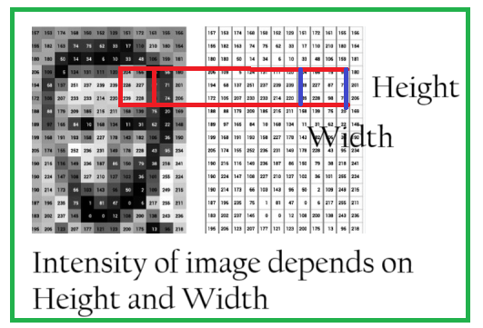
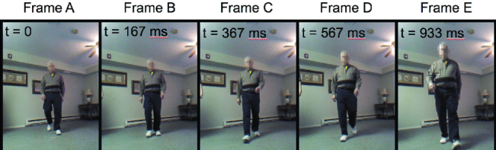
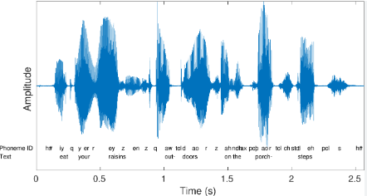
Single Variable (One-Dimensional) and Multi Variable (Multi-Dimensional) Signal
Voice Signal is 1-D or One Variable or One-Dimensional Signal, because its Amplitude changes with respect to Time.
Image is a 2-D or Two Variable or Two-Dimensional Signal, because it depends on two variables height and width of the image to show the resolution or intensity of the Image.
Video is a 3-D or Three Variable or Three-Dimensional Signal, because it depends on image (image is a 2D) per frame to show the motion of Video Signals.

Slide 17
Classification of Signals On the Basis of Type

Slide 18
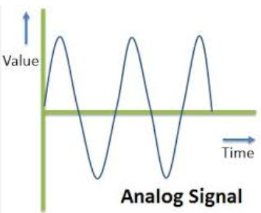
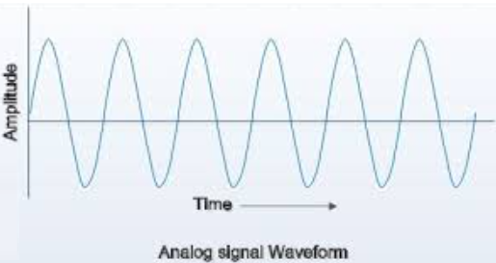
Analog Signal
In Analog Signal, the physical quantities such as Current or Voltage varies continuously with time.
Examples of such signals are Sinusoidal Wave, Triangular Wave etc.

Slide 19
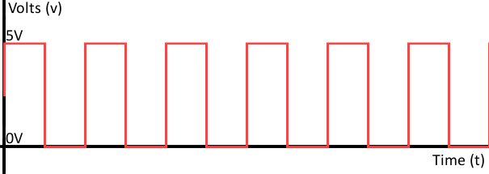
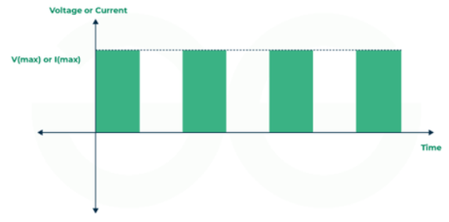
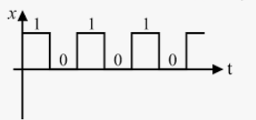
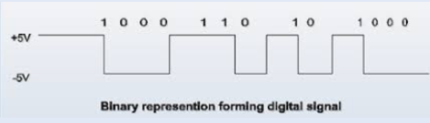
Digital Signal
In digital signal, the physical quantities such as current or voltage can have only one of the two possible values at a time, i.e., digital signal have only levels, either zero or some maximum finite value of current or voltage.
These signals get stored in the form of binary bit.

Slide 20
Classification of Signals On the Basis of Time

Slide 21
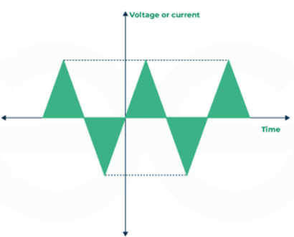
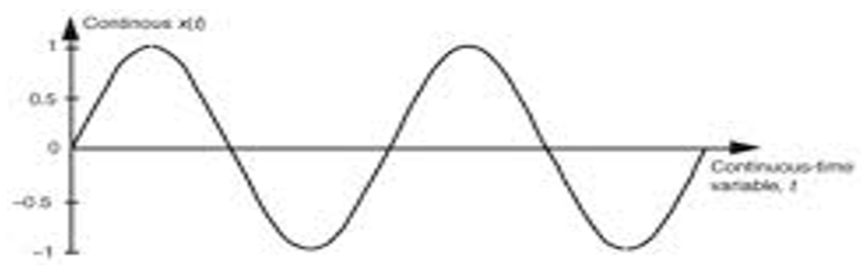
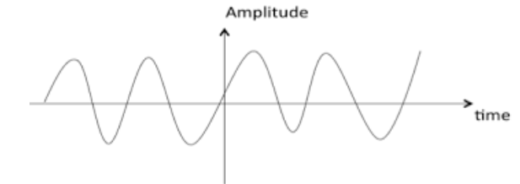
Continuous Time Signal
In continuous-time signal at each point of time, signal will have some continuous values.
These of signals can be analyzed using techniques such as Fourier or Laplace transformations.
It requires more space than discrete-time signal because it has to be firstly sampled before transmission.
This signal has infinite bandwidth and can be represented using signals like sine or cosine waves.

Slide 22
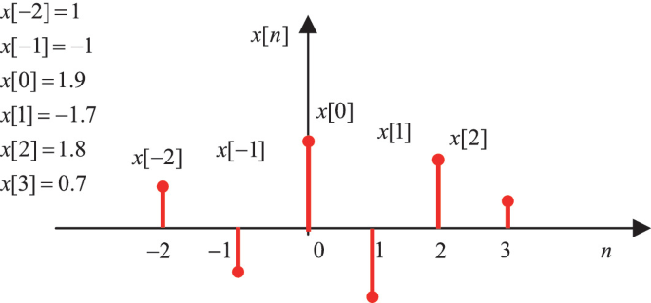
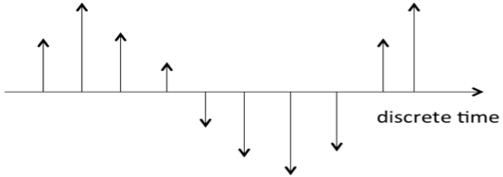
Discrete Time Signal
In discrete-time signal at each point of time, signal will have distinct or discontinuous values.
These types of signals can be analyzed using techniques like discrete Fourier transformations or z-transformations.
It requires less space than continuous-time signal as they are represented by some specific set of numbers. Discrete-time signal has finite bandwidth.

Slide 23
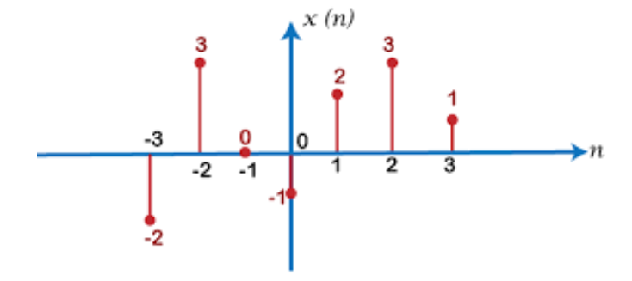
$$Q: Draw the Discrete Time Signal, x\left[n\right]=\{−2, 3, 0, −1, 2, 3, 1\}$$
SOLUTION

Slide 24
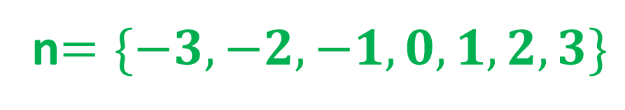
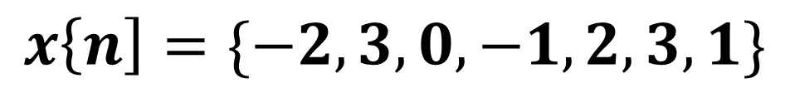
$$Q:Calculate the x\left[n\right]Sample from Discrete Timw Signal$$
SOLUTION
$$x\left\{n\right]=\{−2, 3, 0, −1, 2, 3, 1\}$$
n$=\{−3, −2, −1, 0, 1, 2, 3\}$

Slide 25
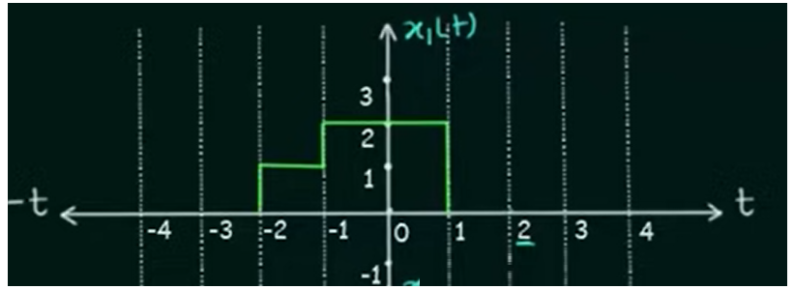
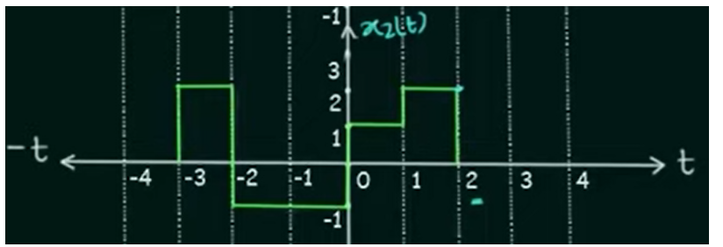
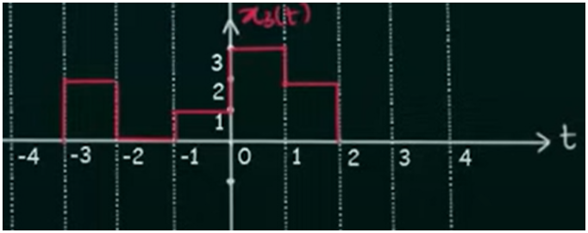
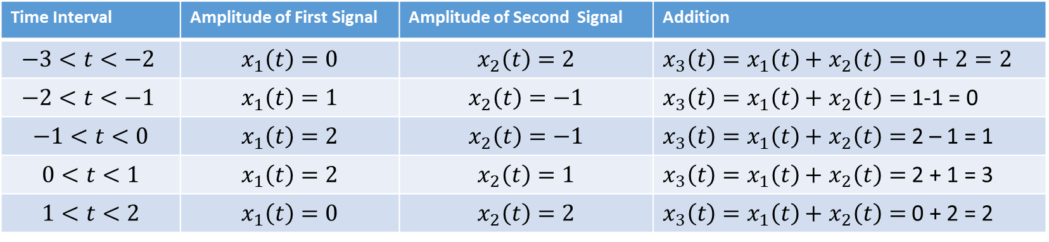
Addition of Continuous Time Signal
Time Interval | Amplitude of First Signal | Amplitude of Second Signal | Addition
$$−3<t<−2$$ | $$x_{1}\left(t\right)=0$$ | $$x_{2}\left(t\right)=2$$ | $x_{3}\left(t\right)=x_{1}\left(t\right)+$ $x_{2}\left(t\right)=0+2=2$
$$−2<t<−1$$ | $$x_{1}\left(t\right)=1$$ | $$x_{2}\left(t\right)=−1$$ | $x_{3}\left(t\right)=x_{1}\left(t\right)+$ $x_{2}\left(t\right)=$ 1-1 = 0
$$−1<t<0$$ | $$x_{1}\left(t\right)=2$$ | $$x_{2}\left(t\right)=−1$$ | $x_{3}\left(t\right)=x_{1}\left(t\right)+$ $x_{2}\left(t\right)=$ 2 – 1 = 1
$$0<t<1$$ | $$x_{1}\left(t\right)=2$$ | $$x_{2}\left(t\right)=1$$ | $x_{3}\left(t\right)=x_{1}\left(t\right)+$ $x_{2}\left(t\right)=$ 2 + 1 = 3
$$1<t<2$$ | $$x_{1}\left(t\right)=0$$ | $$x_{2}\left(t\right)=2$$ | $x_{3}\left(t\right)=x_{1}\left(t\right)+$ $x_{2}\left(t\right)=$ 0 + 2 = 2

Slide 26
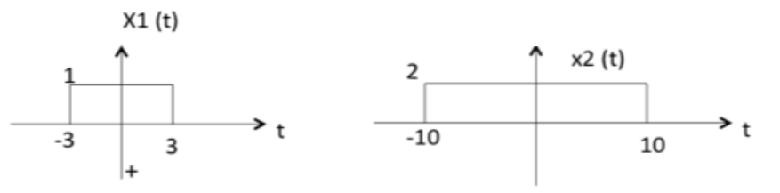
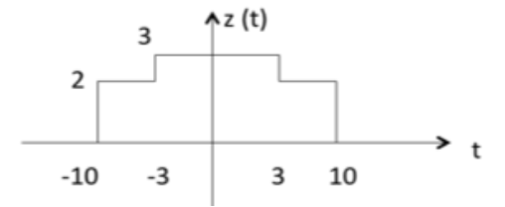
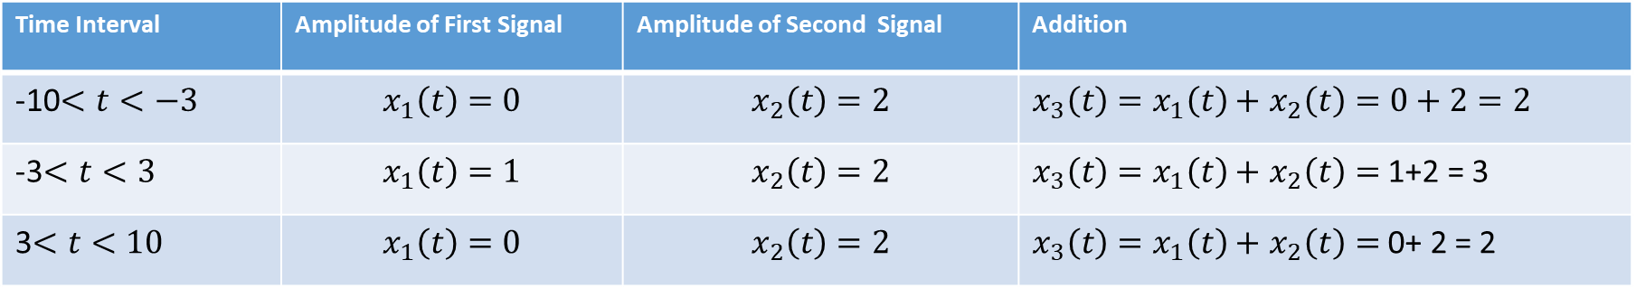
Addition of Continuous Time Signal
Time Interval | Amplitude of First Signal | Amplitude of Second Signal | Addition
-10$<t<−3$ | $$x_{1}\left(t\right)=0$$ | $$x_{2}\left(t\right)=2$$ | $x_{3}\left(t\right)=x_{1}\left(t\right)+$ $x_{2}\left(t\right)=0+2=2$
-3$<t<3$ | $$x_{1}\left(t\right)=1$$ | $$x_{2}\left(t\right)=2$$ | $x_{3}\left(t\right)=x_{1}\left(t\right)+$ $x_{2}\left(t\right)=$ 1+2 = 3
3$<t<10$ | $$x_{1}\left(t\right)=0$$ | $$x_{2}\left(t\right)=2$$ | $x_{3}\left(t\right)=x_{1}\left(t\right)+$ $x_{2}\left(t\right)=$ 0+ 2 = 2

Slide 27
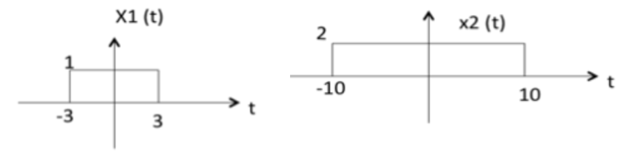
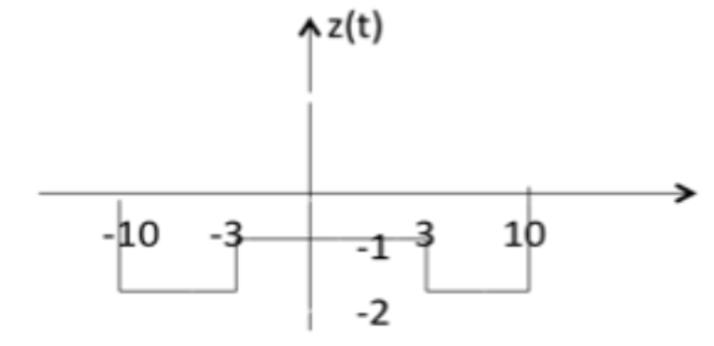
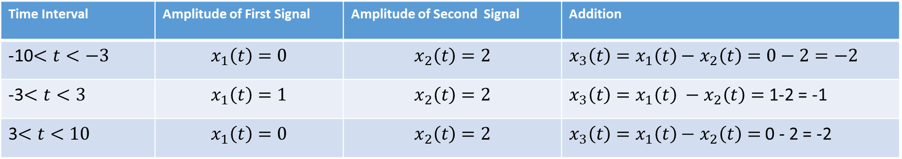
Subtraction of Continuous Time Signal
Time Interval | Amplitude of First Signal | Amplitude of Second Signal | Addition
-10$<t<−3$ | $$x_{1}\left(t\right)=0$$ | $$x_{2}\left(t\right)=2$$ | $x_{3}\left(t\right)=x_{1}\left(t\right)−$ $x_{2}\left(t\right)=0−2=−2$
-3$<t<3$ | $$x_{1}\left(t\right)=1$$ | $$x_{2}\left(t\right)=2$$ | $x_{3}\left(t\right)=x_{1}\left(t\right) −$ $x_{2}\left(t\right)=$ 1-2 = -1
3$<t<10$ | $$x_{1}\left(t\right)=0$$ | $$x_{2}\left(t\right)=2$$ | $x_{3}\left(t\right)=x_{1}\left(t\right)−$ $x_{2}\left(t\right)=$ 0 - 2 = -2

Slide 28
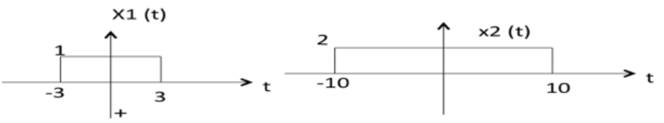
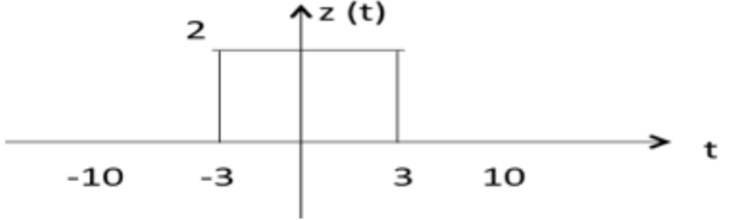
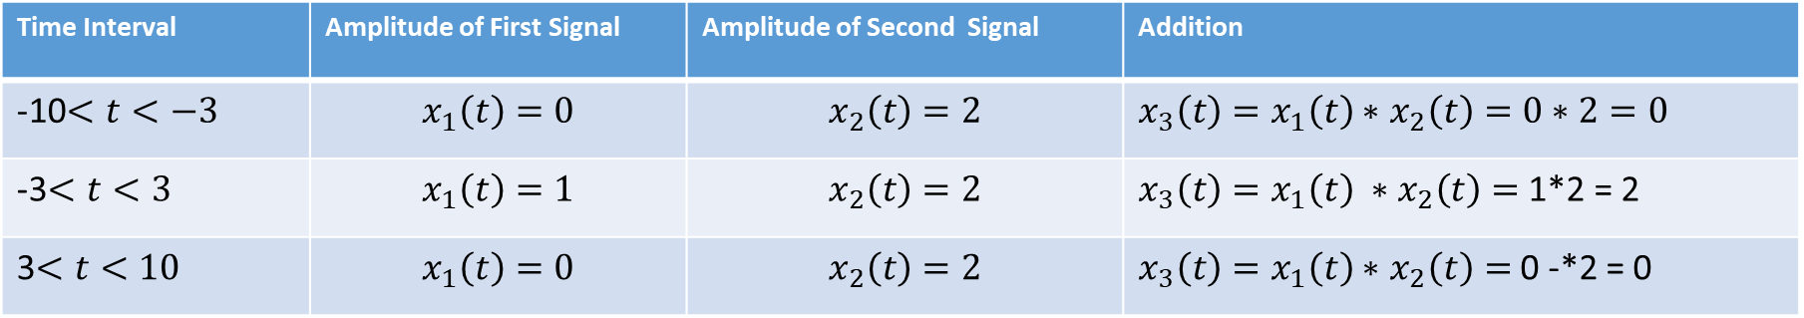
Multiplication of Continuous Time Signal
Time Interval | Amplitude of First Signal | Amplitude of Second Signal | Addition
-10$<t<−3$ | $$x_{1}\left(t\right)=0$$ | $$x_{2}\left(t\right)=2$$ | $x_{3}\left(t\right)=x_{1}\left(t\right)∗$ $x_{2}\left(t\right)=0∗2=0$
-3$<t<3$ | $$x_{1}\left(t\right)=1$$ | $$x_{2}\left(t\right)=2$$ | $x_{3}\left(t\right)=x_{1}\left(t\right) ∗$ $x_{2}\left(t\right)=$ 1*2 = 2
3$<t<10$ | $$x_{1}\left(t\right)=0$$ | $$x_{2}\left(t\right)=2$$ | $x_{3}\left(t\right)=x_{1}\left(t\right)∗$ $x_{2}\left(t\right)=$ 0 -*2 = 0

Slide 29
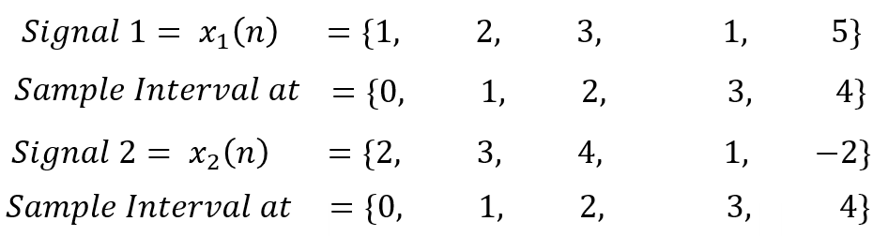
Addition of Discrete Time Signal
$Sample Interval at=0=x_{1}\left(n\right)$ + $x_{2}\left(n\right)=1+2=3$
$Sample Interval at=1=x_{1}\left(n\right)$ + $x_{2}\left(n\right)=2+3=5$
$Sample Interval at=2=x_{1}\left(n\right)$ + $x_{2}\left(n\right)=3+4=7$
$Sample Interval at=3=x_{1}\left(n\right)$ + $x_{2}\left(n\right)=1+1=2$
$Sample Interval at=4=x_{1}\left(n\right)$ + $x_{2}\left(n\right)=5−2=3$
$x_{1}\left(n\right)$ + $x_{2}\left(n\right)=\left\{3, 5, 7, 2, 3\right\}−−−−Answer$

Slide 30
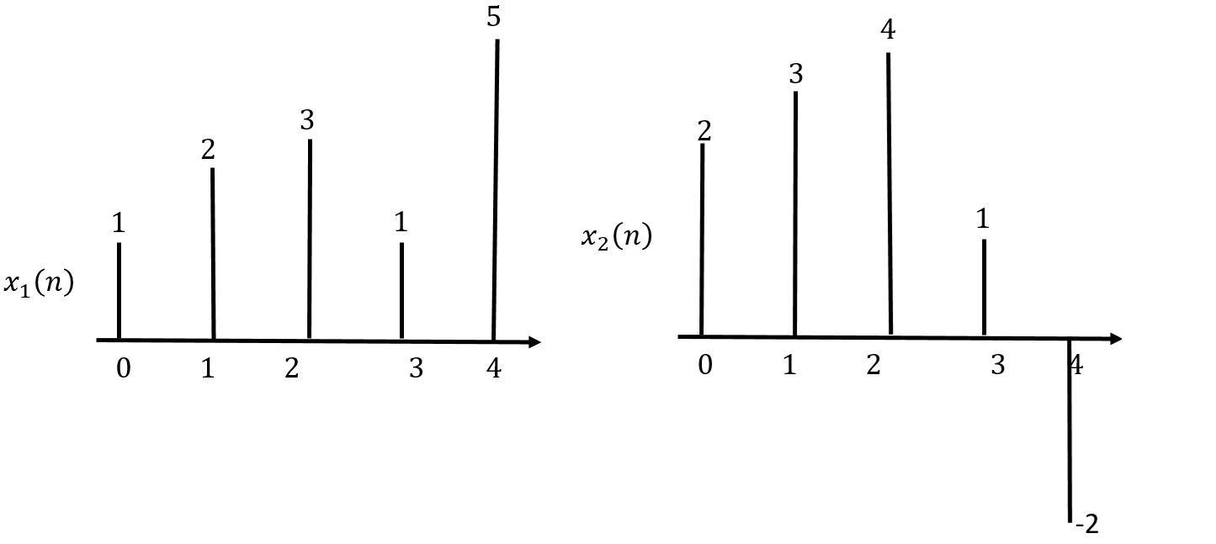
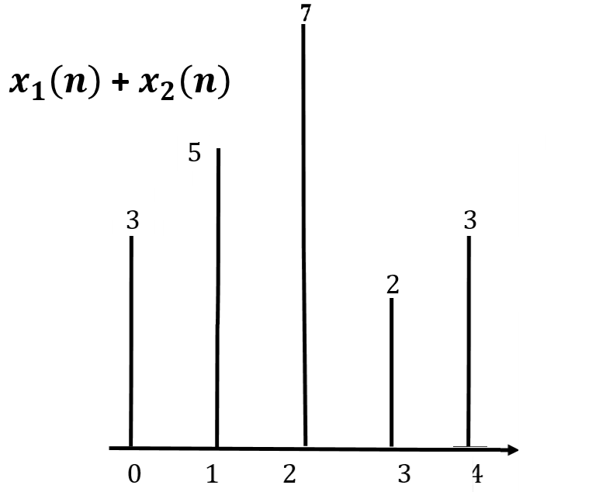
Addition of Discrete Time Signal
$Sample Interval at=0=x_{1}\left(n\right)$ + $x_{2}\left(n\right)=1+2=3$
$Sample Interval at=1=x_{1}\left(n\right)$ + $x_{2}\left(n\right)=2+3=5$
$Sample Interval at=2=x_{1}\left(n\right)$ + $x_{2}\left(n\right)=3+4=7$
$Sample Interval at=3=x_{1}\left(n\right)$ + $x_{2}\left(n\right)=1+1=2$
$Sample Interval at=4=x_{1}\left(n\right)$ + $x_{2}\left(n\right)=5−2=3$
$x_{1}\left(n\right)$ + $x_{2}\left(n\right)=\left\{3, 5, 7, 2, 3\right\}−−−−Answer$

Slide 31
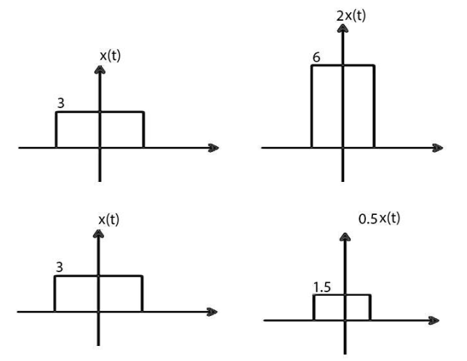
Scaling
Scaling of a signal means, a constant value is multiplied with the time or amplitude of the signal is called Scaling
$$x\left(t\right)=3, then 2∗x\left(t\right)=2∗3=6$$
$$x\left(t\right)=3, then 0.5∗x\left(t\right)=0.5∗3=1.5$$

Slide 32
Types of Scaling
Amplitude Scaling
Time Scaling

Slide 33
Time Scaling
The Compression or Expansion of a signal in time is called as Time Scaling.

Slide 34
Periodic Signals

Slide 35
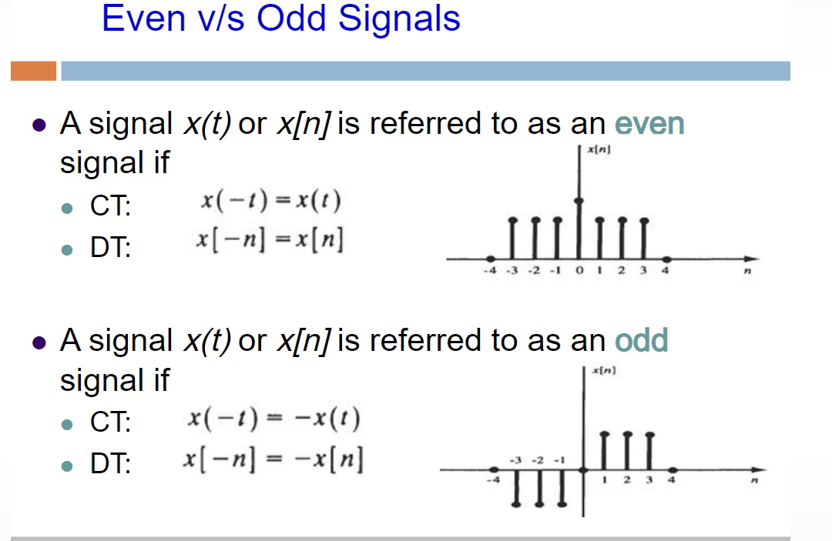

Slide 36
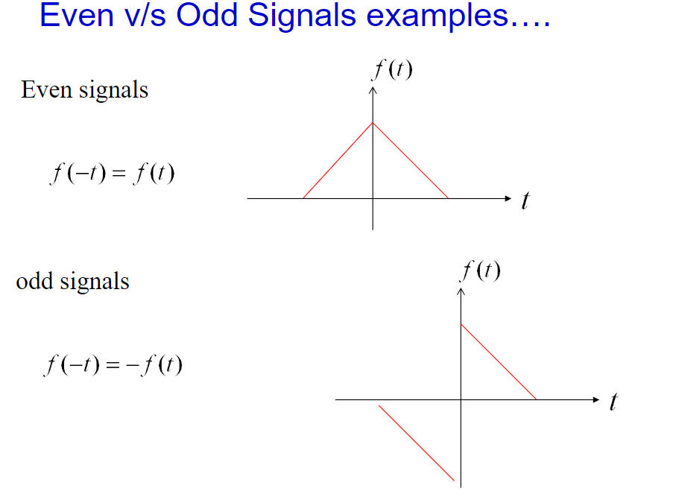

Slide 37
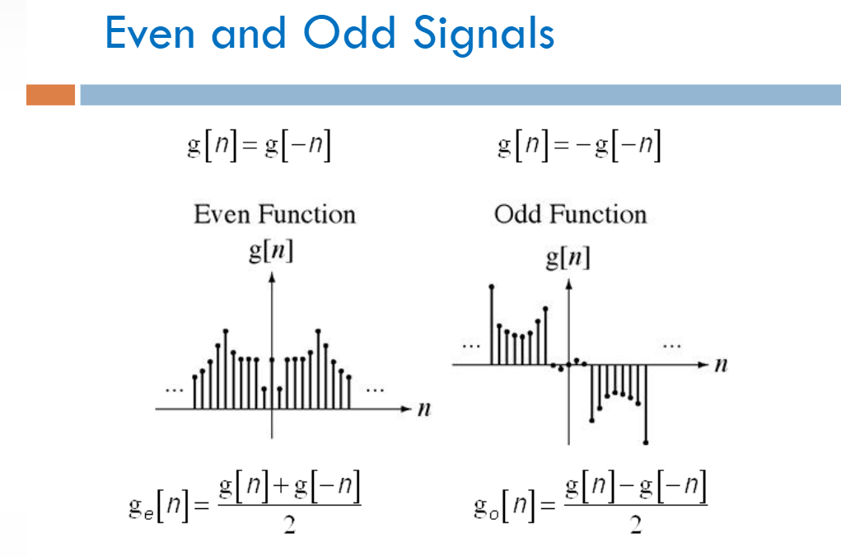

Slide 38
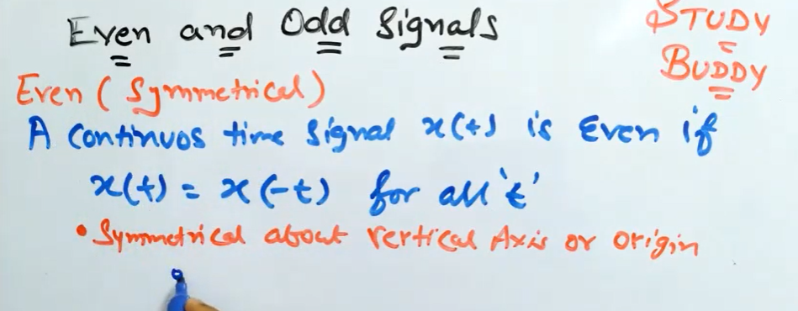
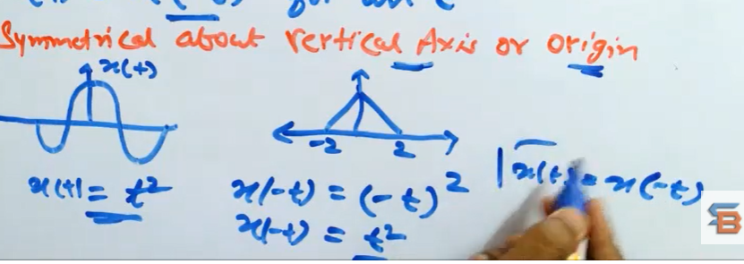


Even And Odd Signals

Slide 39



Slide 40


Slide 41


Slide 42


Slide 43


Slide 44



Slide 45


Slide 46




Odd Signal
Antisymmetric Signal is known as Odd Signal.

Slide 47


Slide 48


Slide 49


Slide 50
Exponential Signals

Slide 51
Sinusoidal Signals

Slide 52
Energy and Power
Energy is the ability to do work.
Power is the energy per unit time is called Power.
$$\left.Power=\frac{Energy}{Time}−−−−−−−−−−−−−−−−−−−−−−−(1\right)$$

Slide 53
Digital Signal Processing (DSP)
Lecture-1 Signals and its Types
By
Dr. Wazir Muhammad Laghari
Biomedical Engineering Department
BUET, Khuzdar

Slide 54
Course outline:

